Slide 1
Informed search algorithms
10918
1

Slide 2
Outline
Best-first search
Greedy best-first search
A* search
Heuristics
Local search algorithms
Hill-climbing search
Simulated annealing search
Local beam search
Genetic algorithms
10918
1

Slide 3
Heuristic
Heuristic: heuristic (from Greek εὑρίσκω "I find, discover") is a technique designed for solving a problem more quickly when classic methods are too slow, or for finding an approximate solution when classic methods fail to find any exact solution
10918
1

Slide 4
Best-first search
The general approach we consider is called best first search.
Best-first search is an instance of the general Tree-Search or Graph-Search algorithm in which a node is selected for expansion based on an evaluation function, f(n).
The evaluation function is construed as a cost-estimate, so the node with the lowest evaluation is expanded first.
The implementation of best first graph search is identical to that for Uniform-Cost Search, except for the use of f instead of g to order the priority queue.
10918
1

Slide 5
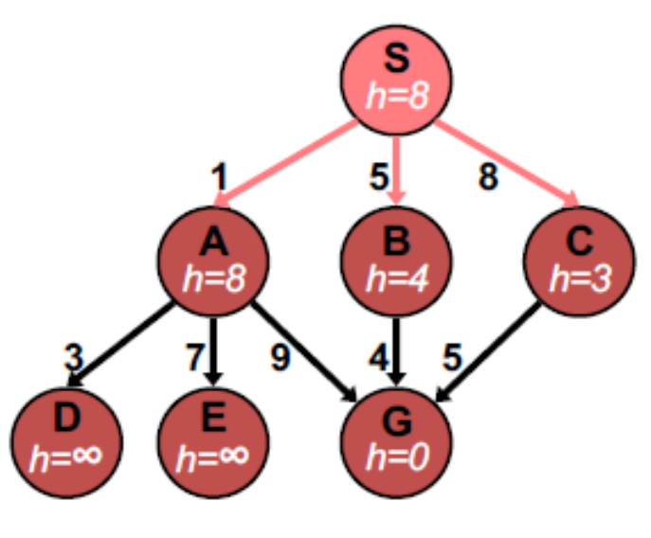
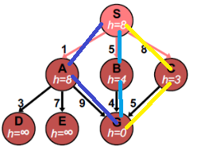
Example for Best First Search
10918
1

Slide 6
Best-first search
Idea: use an evaluation function f(n) for each node
  estimate of "desirability"
  Expand most desirable unexpanded node
Implementation:
Order the nodes in fringe in decreasing order of desirability
Special cases:
  greedy best-first search
  A* search
10918
1

Slide 7
Greedy best-first search
Evaluation function f(n) = h(n) (heuristic)
= estimate of cost from n to goal
e.g., h_{SLD}(n) = straight-line distance from n to Bucharest
Greedy best-first search expands the node that appears to be closest to goal
10918
1

Slide 8
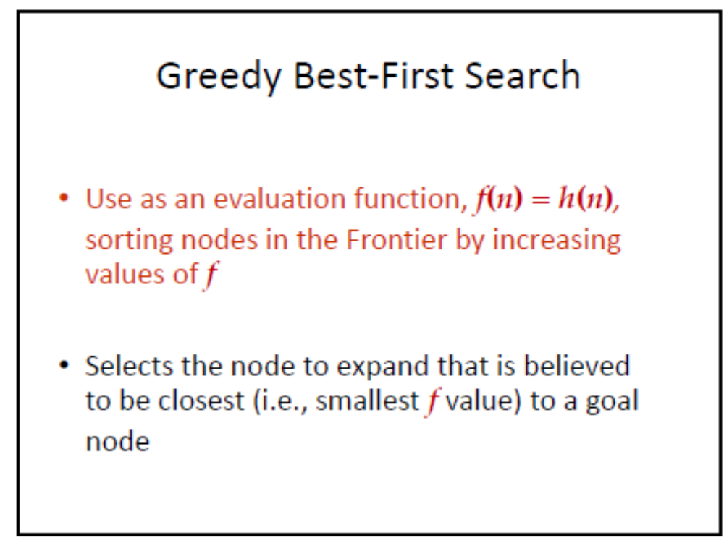
10918
1

Slide 9
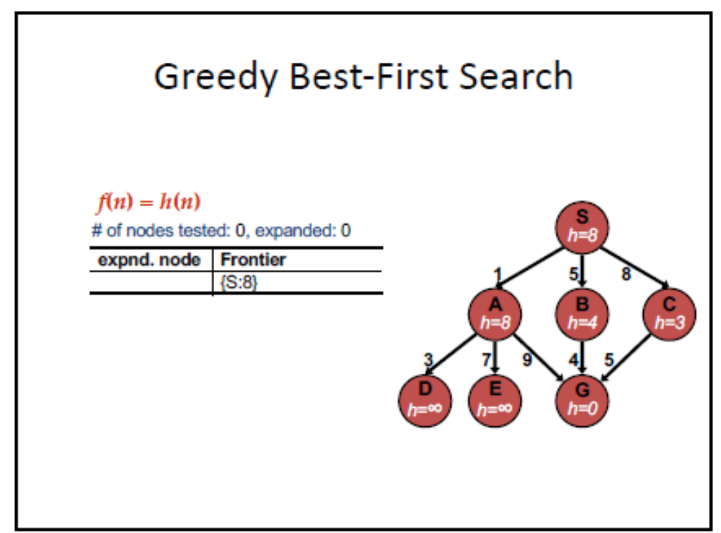

10918
1

Slide 10
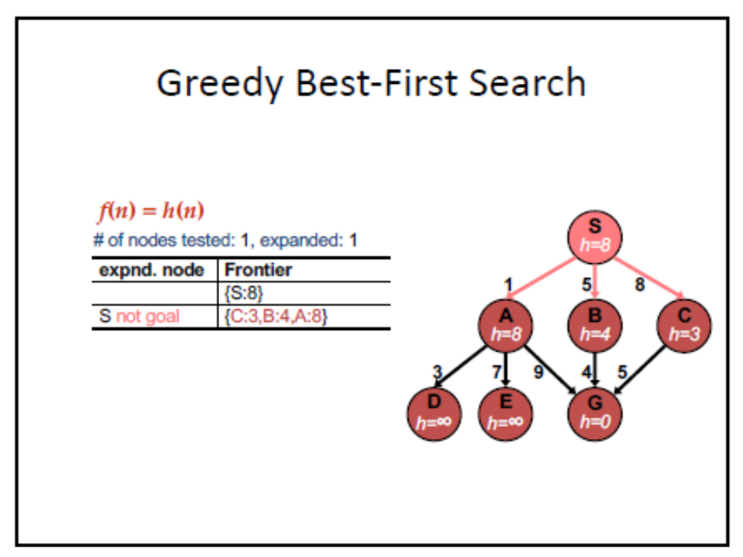
10918
1

Slide 11
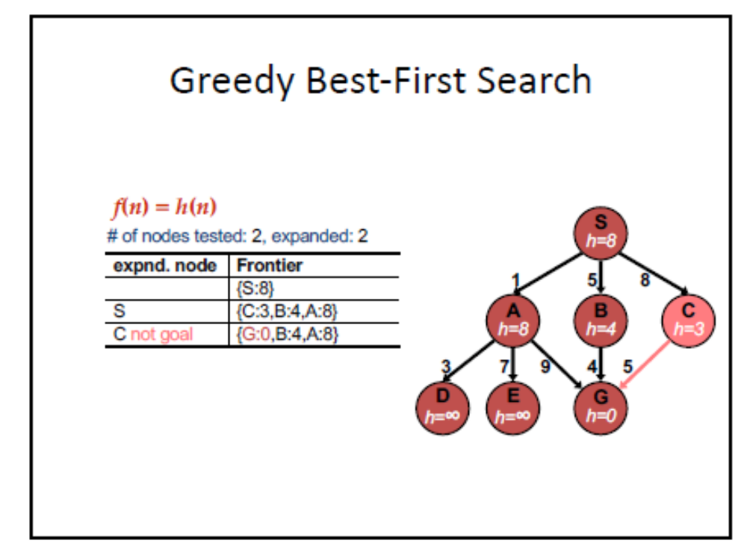
10918
1

Slide 12
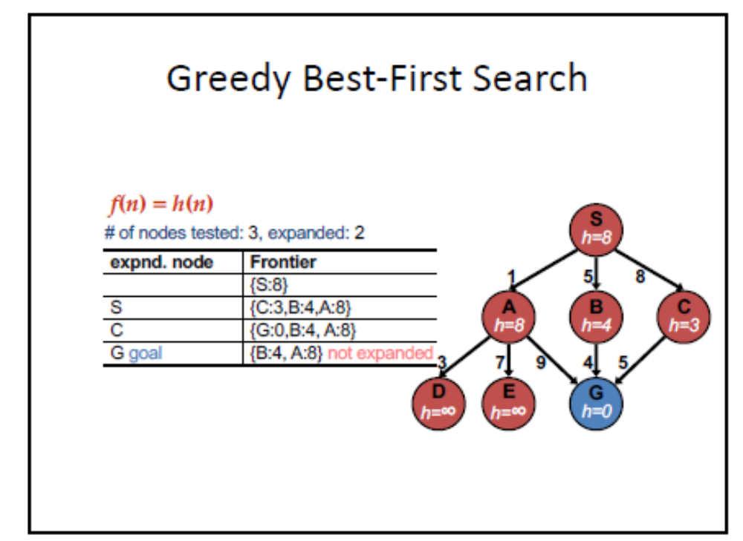
10918
1

Slide 13
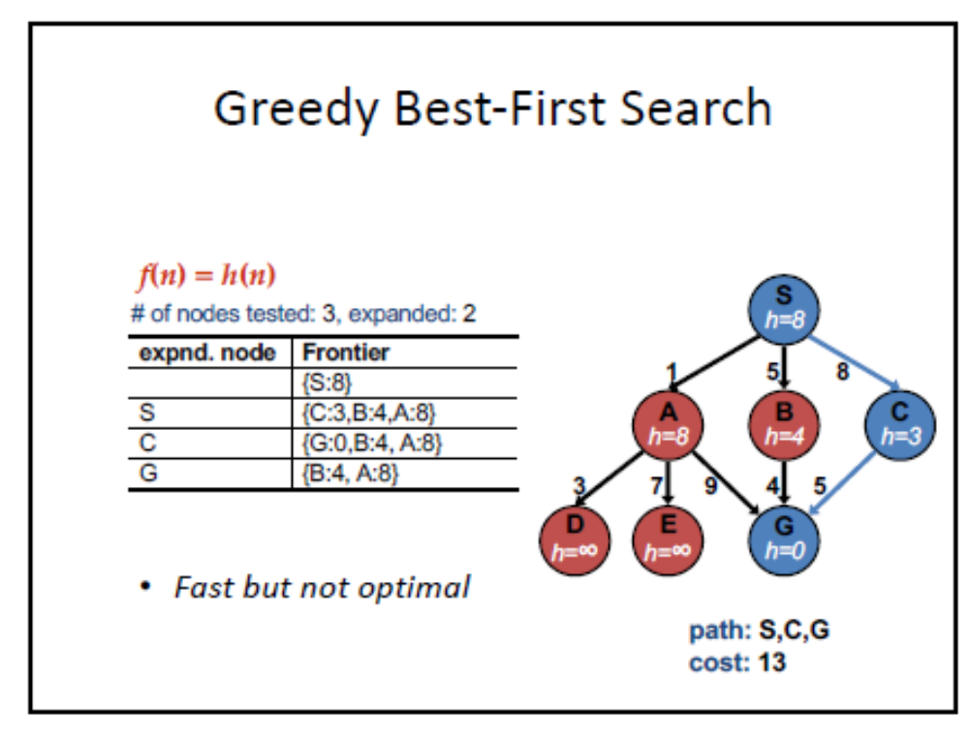
10918
1

Slide 14

Romania with step costs in km
10918
1

Slide 15

Greedy best-first search example
10918
1

Slide 16

Greedy best-first search example
10918
1

Slide 17

Greedy best-first search example
10918
1

Slide 18

Greedy best-first search example
10918
1

Slide 19
Properties of greedy best-first search
Complete? No – can get stuck in loops, e.g., Iasi → Neamt → Iasi → Neamt →
Time? O(b^{m}), but a good heuristic can give dramatic improvement
Space? O(b^{m}) -- keeps all nodes in memory
Optimal? No
10918
1

Slide 20
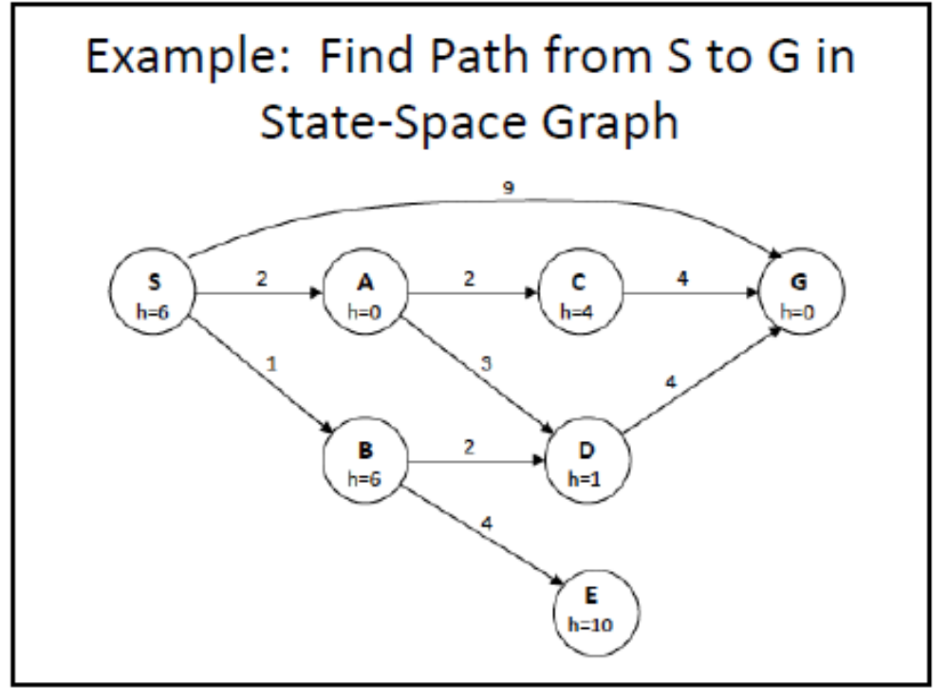
10918
1

Slide 21
A* search
Idea: avoid expanding paths that are already expensive
Evaluation function f(n) = g(n) + h(n)
g(n) = cost so far to reach n
h(n) = estimated cost from n to goal
f(n) = estimated total cost of path through n to goal
10918
1

Slide 22
Working of A*
The algorithm maintains two sets
    OPEN list: The OPEN list keeps track of those nodes that need to be examined.
    CLOSED list: The CLOSED list keeps track of nodes that have already been examined.
Initially, the OPEN list contains just the initial node, and the CLOSED list is empty
    g(n) = the cost of getting from the initial node to n
    h(n) = the estimate, according to the heuristic function, of the cost from n to goal node
    f(n) = g(n)+h(n); intuitively, this is the estimate of the best solution that goes through n
10918
1

Slide 23
Working of A*
Each node also maintains a pointer to its parent, so that the best solution if found can be retrieved.
      It has main loop that repeatedly gets the node, call it n with lowest f(n) value from OPEN list.
      If n is goal node then stop (done) otherwise, n is removed from OPEN list & added to the CLOSED list.
      Next all the possible successor nodes of n are generated.
For each successor node n, if it is already in the CLOSED list and the copy there has an equal or lower f estimate, and then we can safely discard the newly generated n and move on.
      Similarly, if n is already in the OPEN list & the copy there has an equal or lower f estimate, we can discard the newly generated n and move on.
10918
1

Slide 24

A* search example
10918
1

Slide 25

A* search example
10918
1

Slide 26

A* search example
10918
1

Slide 27

A* search example
10918
1

Slide 28

A* search example
10918
1

Slide 29

A* search example
10918
1

Slide 30
A* Properties
Admissible
Optimality
Consistent
10918
1

Slide 31
Admissible heuristics
A heuristic h(n) is admissible if for every node n,
h(n) ≤ h*(n), where h*(n) is the true cost to reach the goal state from n.
An admissible heuristic never overestimates the cost to reach the goal, i.e., it is optimistic
Example: h_{SLD}(n) (never overestimates the actual road distance)
Theorem: If h(n) is admissible, A* using TREE-SEARCH is optimal
10918
1

Slide 32

Optimality of A* (proof)
Suppose some suboptimal goal G₂ has been generated and is in the fringe. Let n be an unexpanded node in the fringe such that n is on a shortest path to an optimal goal G.
f(G₂) = g(G₂) since h(G₂) = 0
g(G₂) > g(G) since G₂ is suboptimal
f(G) = g(G) since h(G) = 0
f(G₂) > f(G) from above
10918
1

Slide 33
Optimality of A* (proof)
Suppose some suboptimal goal G₂ has been generated and is in the fringe. Let n be an unexpanded node in the fringe such that n is on a shortest path to an optimal goal G.
f(G₂) > f(G) from above
h(n) ≤ h*(n) since h is admissible
g(n) + h(n) ≤ g(n) + h*(n)
f(n) ≤ f(G)
Hence f(G₂) > f(n), and A* will never select G₂ for expansion
10918
1

Slide 34

Consistent heuristics
A heuristic is consistent if for every node n, every successor n' of n generated by any action a,
h(n) ≤ c(n,a,n') + h(n')
If h is consistent, we have
f(n') = g(n') + h(n')
= g(n) + c(n,a,n') + h(n')
≥ g(n) + h(n)
= f(n)
i.e., f(n) is non-decreasing along any path.
Theorem: If h(n) is consistent, A* using GRAPH-SEARCH is optimal
10918
1

Slide 35

Optimality of A*
A* expands nodes in order of increasing f value
Gradually adds "f-contours" of nodes
Contour i has all nodes with f=f_{i}, where f_{i} < f_{i+1}
10918
1

Slide 36
Properties of A*
Complete? Yes (unless there are infinitely many nodes with f ≤ f(G) )
Time? Exponential
Space? Keeps all nodes in memory
Optimal? Yes
10918
1

Slide 37
Memory-Bound Heuristic Search
The iterative deepening are applied in the context of heuristic search result in the Iterative-Deepening A* (IDA*) algorithm which reduce memory requirement for A*
The cut off value f-cost (g+h) is differentiate between IDA* and standard iterative-deepening
There are two recent memory-bounded algorithm
      RBFS (Recursive Best-First Search)
      MA* (Memory-bounded A*)
10918
1

Slide 38
RBFS (Recursive Best-First Search)
It is a form of standard best-first search
It is recursive algorithm which perform all operation of best-first search but linear sub space is used
RBFS is very similar to a recursive depth-first search
But it does not search continuing indefinitely down the current path. It has capability to keep track of the F-value of the best alternative path available from any ancestor of the current node
The recursion unwind back to the alternative path if the current node cross this limit
Speciality of RBFS is that it remembers the F-value of the best leaf in the forgotten subtree. (It helps to take decision regarding re-expanding the subtree)
10918
1

Slide 39
RBFS (Recursive Best-First Search)
RBFS is more reliable, cost effective than IDA, but it has critical problem of excessive node generation
RBFS is optimal like A* if the heuristic function h(n) is admissible
RBFS space complexity is O(bd)
RBFS time complexity is difficult to characterize. It is dependent on the parameters
      The accuracy of the heuristic function
      The best path varies with node exploration
The complexity of IDA* and RBFS increases in exponential order which is associated with search graph, as it only checks for repeated states on the current path
Both IDA* and RBFS suffer from too little memory
10918
1

Slide 40
Simplified Memory-bounded A* (SMA)
SMA is very simple and small it performs like A* expanding the best leaf until memory is full
It first drop on an old node and then add a new node to the search tree
The node with highest f-value i.e. worst leaf node is always dropped in SMA
The operation such as delete and expansion are applied
Expansion of new best node and deletion of oldest worst leaf
The node at depth d, shallowest goal node, which occupies less memory size, thus SMA * is complete and solution is reachable
10918
1

Slide 41
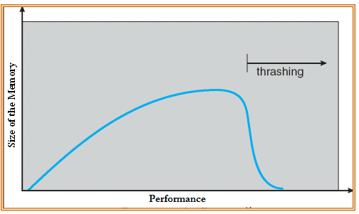
When the state space is graph, the SMA algorithm works as efficient general purpose algorithm for finding solution.
  Here step costs are not uniform and node expansion is very costly that the additional overhead of maintaining the open and closed list
Thrashing
processes on system require more memory than it has
    process doesn’t reuse memory, so caching doesn’t work
    process does reuse memory, but it does not “fit”
    Individually, all processes fit and reuse memory, but too many for system
1
10918

Slide 42

Admissible heuristics
E.g., for the 8-puzzle:
h₁(n) = number of misplaced tiles
h₂(n) = total Manhattan distance
(i.e., no. of squares from desired location of each tile)
h₁(S) = ?
h₂(S) = ?
10918
1

Slide 43
Admissible heuristics
E.g., for the 8-puzzle:
h₁(n) = number of misplaced tiles
h₂(n) = total Manhattan distance
(i.e., no. of squares from desired location of each tile)
h₁(S) = ? 8
h₂(S) = ? 3+1+2+2+2+3+3+2 = 18
10918
1

Slide 44
Dominance
If h₂(n) ≥ h₁(n) for all n (both admissible)
then h₂ dominates h₁
h₂ is better for search
Typical search costs (average number of nodes expanded):
d=12 IDS = 3,644,035 nodes
A*(h₁) = 227 nodes
A*(h₂) = 73 nodes
d=24 IDS = too many nodes
A*(h₁) = 39,135 nodes
A*(h₂) = 1,641 nodes
10918
1

Slide 45
Relaxed problems
A problem with fewer restrictions on the actions is called a relaxed problem
The cost of an optimal solution to a relaxed problem is an admissible heuristic for the original problem
If the rules of the 8-puzzle are relaxed so that a tile can move anywhere, then h₁(n) gives the shortest solution
If the rules are relaxed so that a tile can move to any adjacent square, then h₂(n) gives the shortest solution
10918
1

Slide 46
Local search algorithms
In many optimization problems, the path to the goal is irrelevant; the goal state itself is the solution
State space = set of "complete" configurations
Find configuration satisfying constraints, e.g., n-queens
In such cases, we can use local search algorithms
keep a single "current" state, try to improve it
10918
1

Slide 47
Advantages of Local Search
Memory requirement is less (as total search space is not searched) than normal blind search
They normally find reasonably fast solution in big search space
10918
1

Slide 48
Local Search Technique
Start with initial state. If it is nota goal state, go to step 2
Repeat the following till either goal state is reached or applicable operations are over:
  Select yet unapplied operator, apply it to produce new state, which moves in the direction of increasing value of evaluation function.
  Evaluate new state. If it is goal state on no operator generates state having value of objective function more than previous one, then terminate.
10918
1

Slide 49

Terminology of Local Search
State Space Landscape
Global Maximum
Global Minimum
10918
1

Slide 50
A Landscape: both location and elevation defined by the value of the heuristic cost function or objective function
Global minimum: To find the lowest valley (if elevation corresponds to cost)
Global maximum: Finding the highest peak (if elevation corresponds to an objective function)
Ridges: A sequence of local maxima that is very difficult for navigate
Plateaux: Area of the state space landscape where the evaluation function is flat
10918
1

Slide 51
Types of Local Search
Hill-climbing Search
Simulation Annealing Search
Genetic Algorithm
10918
1

Slide 52

Example: n-queens
Put n queens on an n × n board with no two queens on the same row, column, or diagonal
10918
1

Slide 53
Hill-climbing search
It always moves towards the goal
Using heuristics it finds which direction will take it closest to the goal
It is actually combination of Generate-and-test + Direction to move
Here the heuristic function is to estimate how close a given state is to a goal state
10918
1

Slide 54
Algorithm Steps for Hill-climbing
STEP 1: Evaluate the initial state, if it is goal state then quit otherwise make current state as initial state
STEP 2: Select a new operator that could be applied to this state and generate a new state
STEP 3: Evaluate the new state if this new state is closer to the goal state, then current state make the new state as the current if it is not better ignore this state and proceed with the current state
STEP 4: If the current state is goal state or no new operators are available, Quit. Otherwise go to STEP 2.
10918
1

Slide 55

Hill-climbing search
"Like climbing Everest in thick fog with amnesia"
Sometimes called greedy local search
10918
1

Slide 56

Hill-climbing search: 8-queens problem
h = number of pairs of queens that are attacking each other, either directly or indirectly
h = 17 for the above state
10918
1

Slide 57

Hill-climbing search: 8-queens problem
A local minimum with h = 1
10918
1

Slide 58
Simulated annealing search
Initially the whole space is explored.
It makes the procedure less sensitive to the starting point
It avoid false foot hills based on the following changes done in this approach
  Rather than creating maxima; minimisation is done
  The term objective function is used rather than heuristic
10918
1

Slide 59
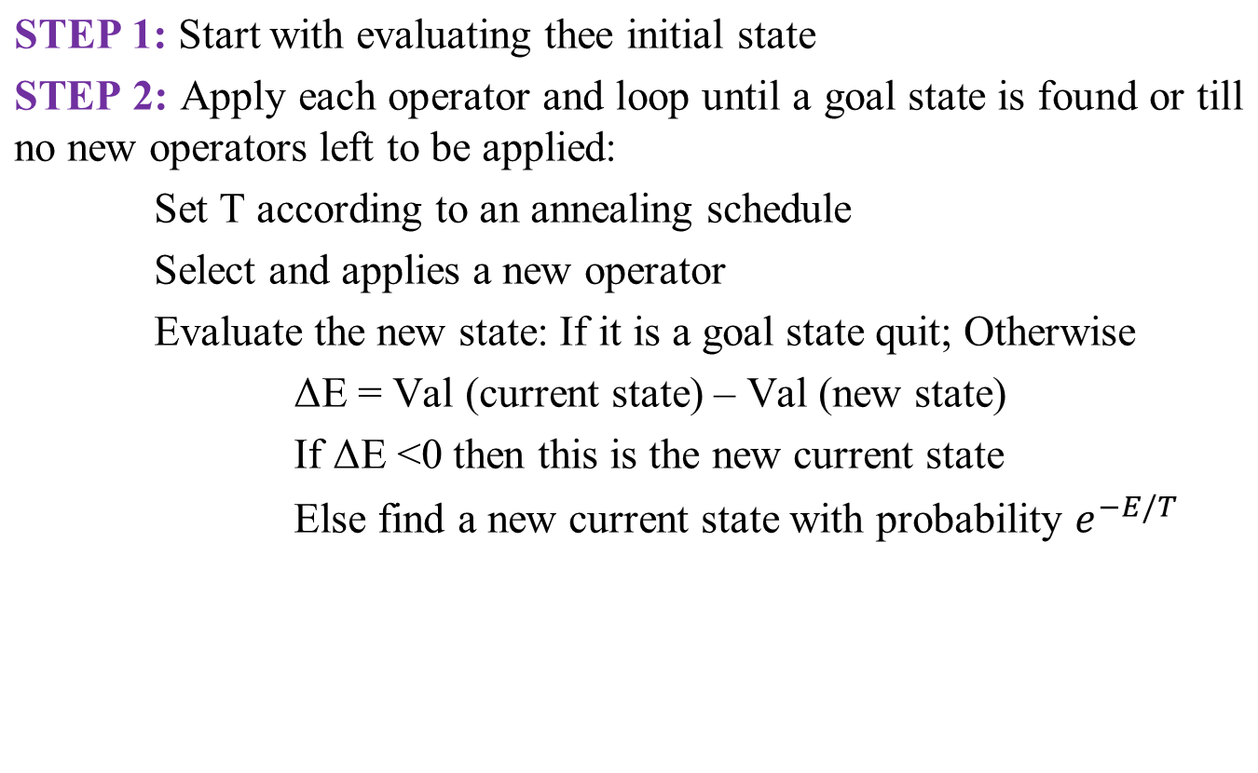
Algorithm form of Simulated annealing search
10918
1

Slide 60

Simulated annealing search
Idea: escape local maxima by allowing some "bad" moves but gradually decrease their frequency
10918
1

Slide 61
Properties of simulated annealing search
One can prove: If T decreases slowly enough, then simulated annealing search will find a global optimum with probability approaching 1
Widely used in VLSI layout, airline scheduling, etc.,
Types of searches in this method as shown below
        Local Beam search
        Stochastic Beam search
10918
1

Slide 62
Local Beam search
In this search, instead of single state in memory K states are kept in memory
Here states are generated in random fashion
A successor function plays an important role by generating successor of all K states
If any one successor state is goal state then no further processing is required
In other case i.e. if goal state is not achieved it observes the K best successors from the list of all successor and process is repeated.
10918
1

Slide 63
Local Beam search
At the first glance the random parallism is achieved in the sequence by a local beam search with K states
To implement a local search threads are used. The K parallel search threads carry useful information
It work on principle of successful successor. If one state generate good /efficient /goal reaching successor and other K-1 state generate poor successor, then in this situation the successful successors generating state leads the all other states
It drops /leaves the unsuccessful search and concentrate on successful search
10918
1

Slide 64
Local Beam search
Keep track of k states rather than just one
Start with k randomly generated states
At each iteration, all the successors of all k states are generated
If any one is a goal state, stop; else select the k best successors from the complete list and repeat.
LIMITATIONS
Lack of variation among the K states
If the state concentrate on small area of state space then search becomes more expensive
10918
1

Slide 65
Stochastic Beam search
It’s a flavour of Local Beam search it resolve the limitations exist in Local Beam search
It concentrate /focus on random selection of K successor instead of selecting K best successor from candidate successor
The probability of random selection is increasing function of its success rate
It is very similar to natural selection here the child (successor) of a parent state is eugenic (good production) according to it success rate (fitness)
10918
1

Slide 66
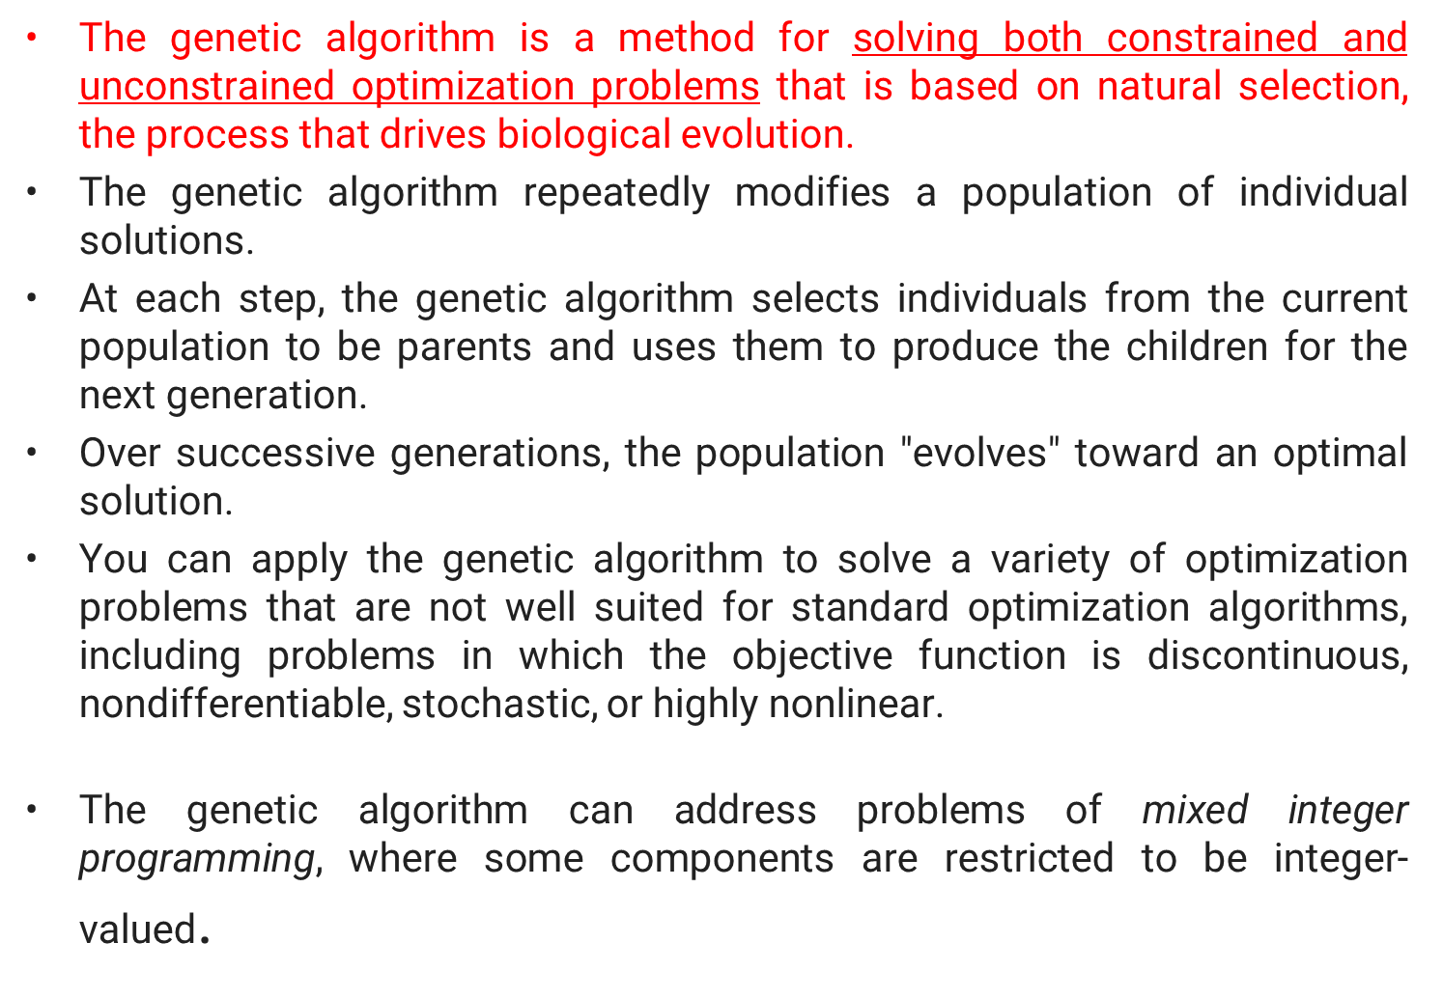
Genetic algorithms
10918
1

Slide 67
Genetic algorithms
A successor state is generated by combining two parent states
Start with k randomly generated states (population)
A state is represented as a string over a finite alphabet (often a string of 0s and 1s)
Evaluation function (fitness function). Higher values for better states.
Produce the next generation of states by selection, crossover, and mutation
10918
1

Slide 68
Population: Population is set of states which are generated randomly
Individual: Each state or individual is a string of finite alphabet (0’s & 1’s )
Fitness function: The evaluation function which specifies the rating of each state is called fitness function
Crossover: For each state pairs are divided that division point or meeting point is called crossover point
Mutation: Mutation is one of the genetic operation. It works on random selections or changes.
Schema: The schema is a substring in which position of some bit can be unspecified
10918
1

Slide 69
Algorithm Representation
Use number of state population or a set of individual
Use fitness function, function of rating
Create an individual ‘x’ (parent) by using random selection with fitness function ’A’ (rate A)
Create an individual ‘y’ (parent) by using random selection with fitness function ’B’ (rate B)
Child with good fitness is created for x+y
For small probability apply mutate operator on child
Add child to new population
The above process is repeated until child (an individual) in not fit as specified fitness function
10918
1

Slide 70

Genetic algorithms
Fitness function: number of non-attacking pairs of queens (min = 0, max = 8 × 7/2 = 28)
24/(24+23+20+11) = 31%
23/(24+23+20+11) = 29% etc.,
10918
1

Slide 71

Genetic algorithms
10918
1

Slide 72
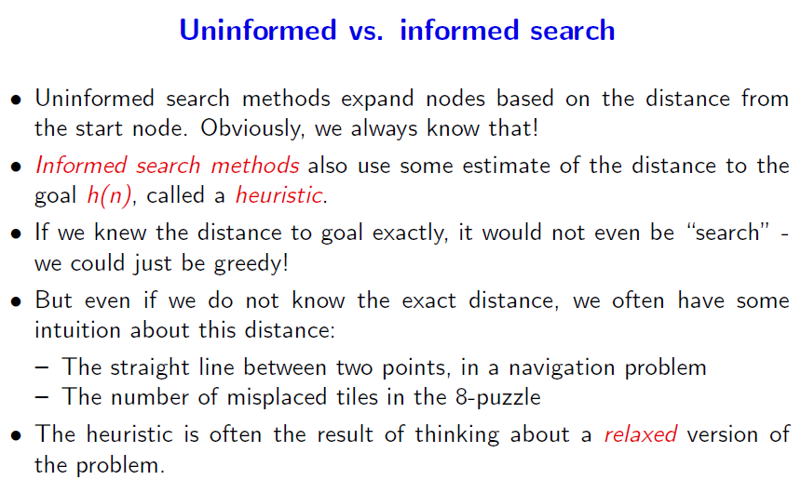
Comparison between Uninformed vs Informed
10918
1

